Slide 1
Data Processing for Machine Learning: Optimization & regularization
DATA REDUCTION in next-gen sequencing
Fred Garza, Morgan Germany, Emmanual Igwilo, Jade Sanchez, Monique Rathnam
08-Jun-2025 - 6253-ITAI-2377-Data Science Artificial Intel-S10-14379
Professor: Sitaram Ayyagari

Slide 2
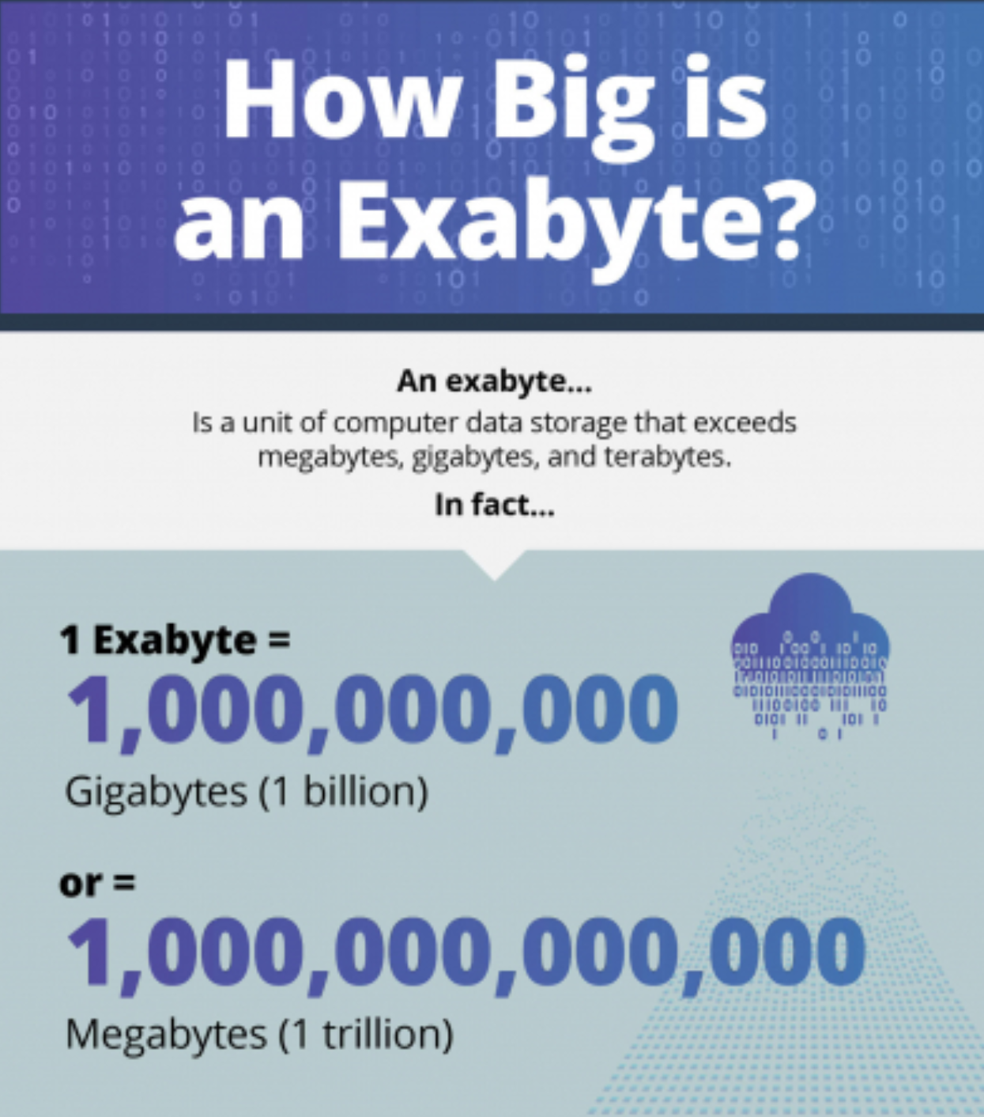
introduction
In healthcare, as more AI-based agents attempt to tackle the task of next-generation sequencing (NGS).
A single human genome can require 200GB to 1TB of storage.
To store the volume of throughput data needed for genetically sequence every human on the planet.
Large-scale genomic databases demand exabytes of space, making traditional storage inefficient.
Genomic data contains repetitive sequences, but traditional storage methods don’t optimize compression effectively.
Notes:
Above info and pic:
https://www.backblaze.com/blog/what-is-an-exabyte/
Weka: https://www.weka.io/learn/cloud-storage/genomics-data-storage/
Metadata: It’s not enough to just store a genome sequence. Scientists must add their annotations, address gaps in the chain, etc., all of which require additional data.
Sequencing: Scientists are not simply reading DNA and then typing out the sequences. They are using powerful analytics and sequencing tools to understand gaps or aberrations in the sequence better. This, in turn, generates an exponentially gigantic pool of research data.
Privacy: We often use the term “human genome” as a generic placeholder… and that’s something that scientists are studying broadly. However, they also research the individual sequences of real people with real health issues. The ethical impact of lost genomic sequence information is profound. Privacy and security controls must be in place for any storage solution.
Workflows: The processing of genomic data involves parallel processing, retrieval, compression/decompression, and verification processes that run multiple times per day. Storing genomic data means having robust and reliable workflows to handle extensive data.
Chain of Custody: Accountability is a significant problem when dealing with large data sets where integrity and privacy are necessary concerns. Having a logging and monitoring solution in place to ensure that ownership and activity can be traced ensures that scientists can trust the data they are working with (and track back through that forensic trail as needed).

Slide 3
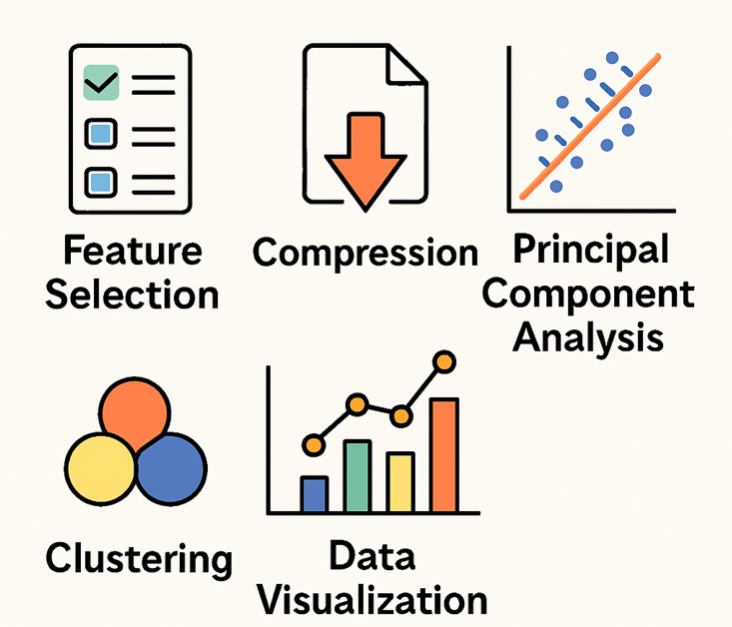
Data Processing for Machine Learning: terminology
Feature Selection
Picking the most important data points and ignoring the rest to make AI faster and smarter.
Compression
Shrinking large amounts of data while retaining key information.
Principal Component Analysis
A method that organizes data to highlight patterns and remove the rest.
Clustering
Grouping similar data together so AI can recognize patterns more efficiently.
Data Visualization
Turning complex data into graphs and charts that make it easier for humans to process the data.
Notes:
FS – Like choosing the best cuts of meat at the butcher.
Comp – Like zipping a file to save space
PCA – Arranging the data into fewer more meaningful components

Slide 4

Techniques and approaches
Feature Selection
By removing irrelevant or redundant features, AI models focus only on the most important data, improving predictions and reducing overfitting (i.e.; learning too much detail from training sets).
Dimensionality Reduction
This approach attempts to reduce the number of “dimensions,” or aspects/variables, from a data set.
A spreadsheet with 10,000 rows but only one column is much simpler to process than one with an additional 500 columns of attributes included. This approach can include compression transformations or even the removal of irrelevant attributes for a specific data mining application.
Notes:
https://www.weka.io/learn/glossary/file-storage/data-reduction/
How to Prevent Overfitting
Use Regularization (e.g., L1/L2 penalties) to simplify the model.
Increase Data Size by collecting more diverse examples.
Apply Dimensionality Reduction to remove redundant features.
Use Dropout in deep learning to prevent dependency on specific neurons.

Slide 5

Real world examples
Pluto Bio
Principal component analysis (PCA) is a commonly used dimensionality reduction technique. PCA reorganizes a dataset into new variables called principal components, which are formed by combining the original variables in a structured way.
Neurosnap AI
Uses PCA as one of many proprietary tools used as a dimensionality reduction technique for genomics and bioinformatics data.
Illumina
Uses PCA as a dimensionality reduction technique for genomics and bioinformatics data.
Space Tango
Works on biological systems modeling in space, using AI to analyze biomanufacturing and regenerative medicine in microgravity. Applies dimensionality reduction to streamline these complex biological datasets.
Notes:
Pluto Bio - https://pluto.bio/product/compute-and-storage
Neurosnap AI - https://neurosnap.ai/service/Kluster
Illumina - https://help.connected.illumina.com/multiomics-software/partek/partek-flow/tutorials/analyzing-cite-seq-data/dimensionality-reduction-and-clustering
Space Tango - https://spacetango.com/

Slide 6
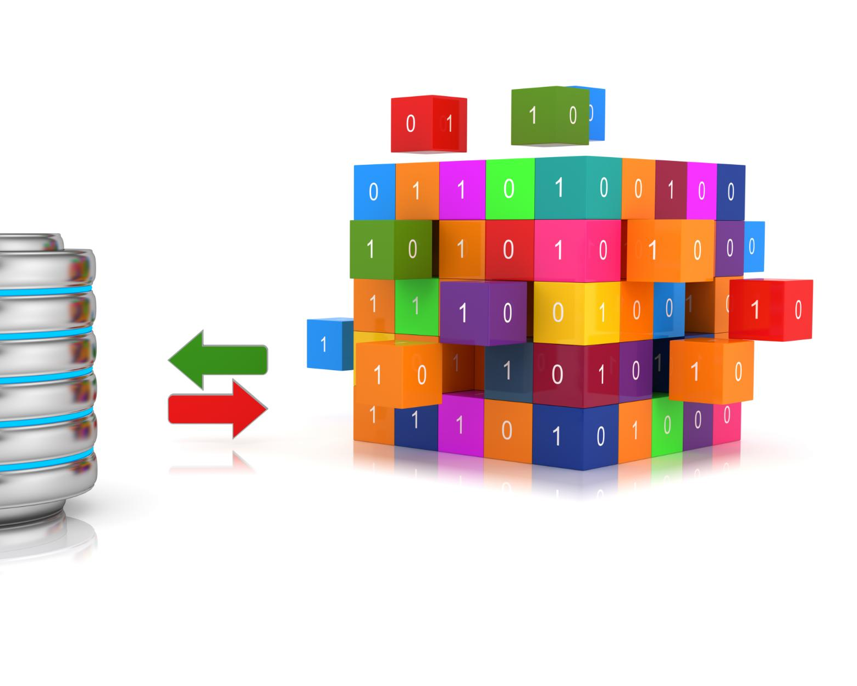
Tools, libraries & platforms
Principal Component Analysis (PCA)
Helps you to reduce the number of features in a dataset while keeping the most important information. It changes your original features into new features these new features don’t overlap with each other and the first few keep most of the important differences found in the original data.
Singular Value Decomposition (SVD)
A technique in linear algebra that breaks a matrix down into three simpler components U (Left Singular Vector), Σ (Singular Values), Vᵀ (Right Singular Vectors). These components simplify matrix operations, making tasks like data reduction, signal processing, and machine learning more efficient.
Linear Discriminant Analysis (LDA)
It finds a linear combination of features that best separates different classes, often used in pattern recognition and face recognition.
T-SNE (stochastic Neural Network with Exemplars)
A technique used to visualize high-dimensional data by reducing it to two or three dimensions while preserving relationships between data points. Widely used in machine learning to explore patterns in data, especially for clustering and anomaly detection
Notes:
https://www.geeksforgeeks.org/dimensionality-reduction/
PCA Sample Algorithm - https://www.geeksforgeeks.org/principal-component-analysis-pca/
SVD -https://www.geeksforgeeks.org/singular-value-decomposition-svd/

Slide 7

Challenges & best practices
Loss of Information
Reducing dimensions means discarding data, which can lead to decreased accuracy in models. Best practice: Variance Analysis, an analysis of the difference between planned and actual numbers.
Interpretability Issues
Transformed features can be harder to understand compared to original ones, making results less intuitive. Best practice: Keep Domain-Relevant Features, which prioritizes components that align with meaningful variables.
Computational Complexity
Some techniques, like t-SNE, are computationally expensive and struggle with large datasets. Best practice: Choose Efficient Algorithms, for large datasets, consider Incremental PCA or randomized SVD.
Overfitting Risk
Selecting too few features can lead to models that don’t generalize well beyond the training data. Best practice: Regularize and Validate, Use cross-validation to verify how well the reduced feature set generalizes.
Notes:
https://www.bing.com/search?q=variance+analysis&cvid=3ef7d677dc0d4fe28135838930b45d64&gs_lcrp=EgRlZGdlKgYIABBFGDkyBggAEEUYOdIBCDMzNDNqMGo0qAIIsAIB&FORM=ANAB01&ucpdpc=UCPD&PC=EDGEDB
https://www.sciencedirect.com/science/article/pii/S266638992500025X
https://www.educative.io/blog/efficient-algorithms
https://en.wikipedia.org/wiki/Algorithmic_efficiency
https://www.geeksforgeeks.org/cross-validation-machine-learning/

Slide 8

Emerging trends / research direction
Utilize (Uniform Manifold Approximation and Projection) UMAP for Better Structure
UMAP combines the power of visualization with the capability to minimize the dimensionality of the data. It preserves both the local and global structures of the data.
Autoencoders for Smarter Compression
AI-powered models that learn to compress data while keeping the most important features.
Multidimensional Scaling for Prioritization
This method helps organize messy data by grouping similar features together, making it easier to analyze trends
Notes:
https://bigdatainterviews.com/qa/what-innovative-methods-reduce-dataset-dimensionality/
https://www.geeksforgeeks.org/umap-uniform-manifold-approximation-and-projection/
https://api4.ai/blog/autoencoders-explained-denoiseampcompress-pics
https://researchmethod.net/multidimensional-scaling/

Slide 9
Visuals
Feature Selection
Picking the most important data points and ignoring the rest to make AI faster and smarter.
Compression
Shrinking large amounts of data while retaining key information.
Principal Component Analysis
A method that organizes data to highlight patterns and remove the rest.
Clustering
Grouping similar data together so AI can recognize patterns more efficiently.
Data Visualization
Turning complex data into graphs and charts that make it easier for humans to process the data.

Slide 10

Summary & takeaways
Filter Methods
Filter methods assess the relevance of features based on statistical measures. They are independent of the model and are often fast.
Wrapper Methods
Wrapper methods evaluate feature subsets based on model performance. They tend to be more computationally intensive but can yield better results.
Embedded Methods
Embedded methods perform feature selection as part of the model training process, balancing efficiency and performance.
Notes:
Feature selection methods include filter, wrapper, and embedded techniques. These methods help determine the most relevant features, which can improve model efficiency and reduce overfitting.

Slide 11
References & credits
Feature Selection
Picking the most important data points and ignoring the rest to make AI faster and smarter.
Compression
Shrinking large amounts of data while retaining key information.
Principal Component Analysis
A method that organizes data to highlight patterns and remove the rest.
Clustering
Grouping similar data together so AI can recognize patterns more efficiently.
Data Visualization
Turning complex data into graphs and charts that make it easier for humans to process the data.

